Slide 1
Let’s Talk About Text, Baby.
Engaging patients through mobile technology.
Community Health Care Clinic
Family Health Partnership Clinic
Notes:
Laurie Sabol, RN, Care Message Coordinator for Family Health Partnership Clinic in Crystal Lake, Illinois
Mike Romagnoli, Operations Manager, for Community Health Care Clinic, Normal, Illinois

Slide 2
A review of the 2016 health care texting program
funded by
Institute of Medicine Chicago and Telligen Community Initiative
Telligen Community Initiative technology for health care data management and quality improvement
an independent organization of leaders collaborating to improve health care in the Chicagoland community
Notes:
Co-recipients of grants from IOMC and Telligen. These organizations make grants to improve health for underserved populations.

Slide 3
Appointment reminder texting
Diabetes/hypertension
Support texting FHPC
Notes:
Mike will share Community Health Care Clinic’s experience with transitioning from phone calls to texting appointment reminders.
I will discuss Family Health Partnership Clinic’s experience with diabetes and hypertension patient outcomes after they completed the programs. A little about our clinics: we are both sliding scale clinics for uninsured adults. We are located in mid-sized Illinois towns; where we are the safety net primary care for the working poor and significant size Hispanic populations.

Slide 4
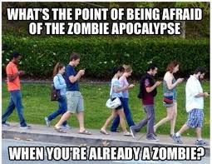
Notes:
When our director approached me about texting, I was a little skeptical. I didn’t have a high opinion of texting; like many parents, something I was forced to pick up because my kids were doing it.

Slide 5
Objectives
Offer information on mobile Health
as it applies to free/charitable clinics
Share Community Health Care Clinic’s and
Family Health Partnership Clinic’s
experience with a patient texting program
Identify resources for free and charitable clinics to launch their own programs
Notes:
We’ll give an overview of mobile health, known as mHealth, as it can apply to free/charitable clinics. We’ll talk about both of our clinics’ experience this past year with a patient texting program, and we’ll identify resources to use if your clinic is considering using texting for patient outreach.

Slide 6
Background
Mobile health or “mHealth” is defined as the practice of medicine and public health using mobile devices.¹
SMS is Short Message Service. (160 characters)
mHealth has evolved as a result of:
The wide availability of cell phones, even among traditionally hard-to-reach populations, such as rural and low-income. Statistics: 86% of Americans with incomes <$30,000 own cell phones. 50% of this group own smartphones.²
The movement toward containing health care costs by
actively involving patients in their care
Notes:
mHealth is the search term you might use to learn more about the types of programs out there. You may have seen the initials SMS, which is basically a text. Mobile health has evolved … Also driving this trend is the movement toward involving patients in their care. As most of you are aware, Medicare and Medicaid are tying dollars to patient outcomes and health care providers are looking for ways to show they are teaching patients to prevent illness and promote health.
86% of Americans with incomes less than $30,000 own a cell phone, with 50% owning smartphones. Texting is a logical answer to the question of, how can we as health care providers better communicate with our patients? It is not meant to replace face-to-face interaction, but rather to supplement it.

Slide 7
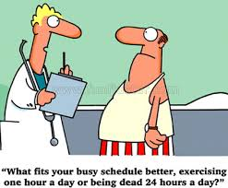
Notes:
So texting has become this tool we can use to really reach patients. Many of us recognize that a diabetic patient is THE person who can have the greatest effect on his or her outcome. We can counsel and advise patients all day long; we can prescribe meds that they may or may not take.
Last fall, the AMA published a study that examined outcomes of 700 patients who completed a texting program aimed at making lifestyle changes such as increasing exercise and smoking cessation. Compared with controls, the patients in the texting program had improved LDL levels, blood pressure, and increased physical activity, as well as higher rates of smoking cessation.

Slide 8
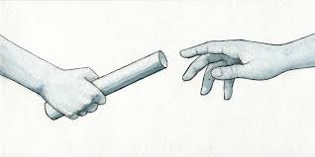
“The basis for our use of the computer in medicine is the thesis that the largest and least utilized provider of health care is the patient.” --Warner Slack, MD, Harvard Medical School Proceedings of the Annual Symposium on Computer Application in Medical Care, 1978³ “Health happens between visits.” --Danny Sands, MD, Co-founder Society for Participatory Medicine Proceedings of the Population Health Forum, Healthcare IT News ⁴
Notes:
Patient empowerment, of course, is not a new concept. This comment is from the annual symposium on computers in medical care in 1978. “The basis for use of the computer in medicine is the thesis that the largest and least utilized provider of health care is the patient.”
And this concept that “health happens between visits” reminds us that we as health care providers are not the ones generating health. The patient is in the driver’s seat, especially for managing and preventing chronic illness.

Slide 9
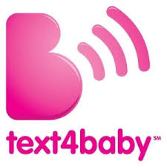
OPENText
A $2million initiative to increase engagement of Medicaid patients in the Chronic Pain Initiative, which seeks alternatives to opioid therapy
Notes:
Just a few examples here of some texting programs in use: The CDC launched Text4baby 6 years ago. Text4Baby is a free cell phone text messaging service for pregnant women and new moms. Text messages are sent three times a week with information on how to have a healthy pregnancy and a healthy baby. The text messages are timed to the pregnant woman’s due date or the baby’s date of birth. OPENText is a clinical trial going on now that is testing the efficacy of a texting program in supporting opioid-dependent patients enrolled in opioid alternative programs. Are patients who get reminders and support every other day more likely to succeed at changing their behavior? And some of you may have heard of the TEXTMe smoking cessation program, which is described as a personal health coach via text message available free to anyone who wants to quit smoking. So TEXTMe and Text4Baby are programs anyone can use for their patients. Many other texting programs involve purchasing a subscription or buying software.

Slide 10
Notes:
Part of this grant was the collaboration aspect. Our clinics use the same EMR and we both used CareMessage texting platform. I hope that sums up some of the background of texting in health care, I’m going to hand it over to Mike now.

Slide 11
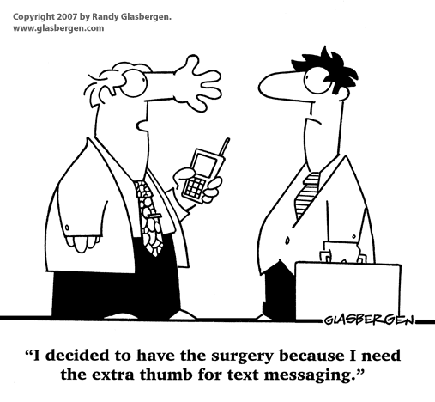
Text Messaging and Appointment Reminders
Notes:
CHCC started using CareMessage for appointment reminders.
Reminder calls prior to CM.
With track phones or “Obama phones”, after early part of month, no more minutes so no calling, but unlimited texting

Slide 12
BT: Before Texting
Notes:
Reminder Calls were made, sometimes sucessfully even. Phone issues
Ran about a 9.7% no show rate, always wanted much lower than this. In first 3 full months of use, went to 8.4%.
Goals: Create a more “fluid” schedule by cancelling appointments farther out and refilling

Slide 13
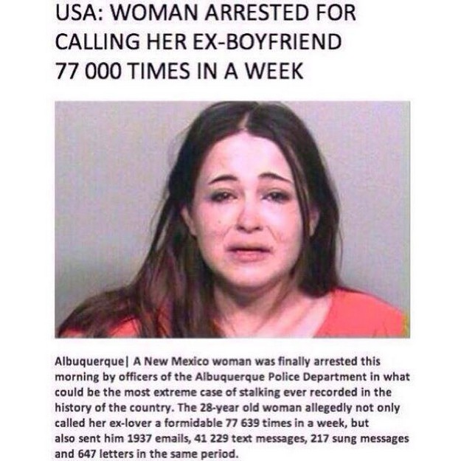
Ready…Set…TEXT!
How do we text?
What do we text?
When do we text?
Are we coming on too strong?
Notes:
I’m more of a “let’s go 100mph and figure it out” versus “Here’s the plan” kind of guy
I was ready to just start texting any and everyone…but that’s not really how it works.
Let patients know that it’s coming. COLLECT PHONE NUMBERS!
What: Appointment reminders (date, time…)
When: Per CareMessage, 9:00 a.m. is the best time, and two reminders, at 5 days and 1 day
Too much? 2 reminders is plenty, more than that is just being clingy.

Slide 14
Internal Considerations
Full Integration
Response Monitoring
Schedule Monitoring
Rescheduling
Notes:
ALL patients would get welcome message. Needed to only do active patients. (first clinic to do full integration)
Who monitors responses?
3. Who is going to keep track of cancellations?
Do we call them to reschedule? Do they NEED to reschedule?
Pre-planning prevents confusion when it comes time to launch! CM Integration plan that was updated almost daily.

Slide 15
Chronic disease texting step by step
Identified diabetic and hypertensive patients through EMR report.
Approached 208 patients; 148 agreed. Obtained separate consent.
Once patients entered into CareMessage, texting is automated.
Excel to enter baseline and followup BP and A1Cs.
Notes:
1 year to get this done: First 12 weeks enrolled patients for the diabetes and hypertension modules and created an Excel database to organize my data. In all, 208 approached 148 yes/60 no. I approached patients in the exam room while waiting for provider. Once we had enough patients, the texting itself is automated by CareMessage. The texts are somewhat two-way. By that I mean, patients can text back answers to questions, such as A or B, Yes or No. However, if patients, for example, type in their blood sugar, or ask questions, they get an automated response to call the clinic if they have specific questions. So that means I wasn’t going in 3 days a week and answering questions from 150 patients.

Slide 16
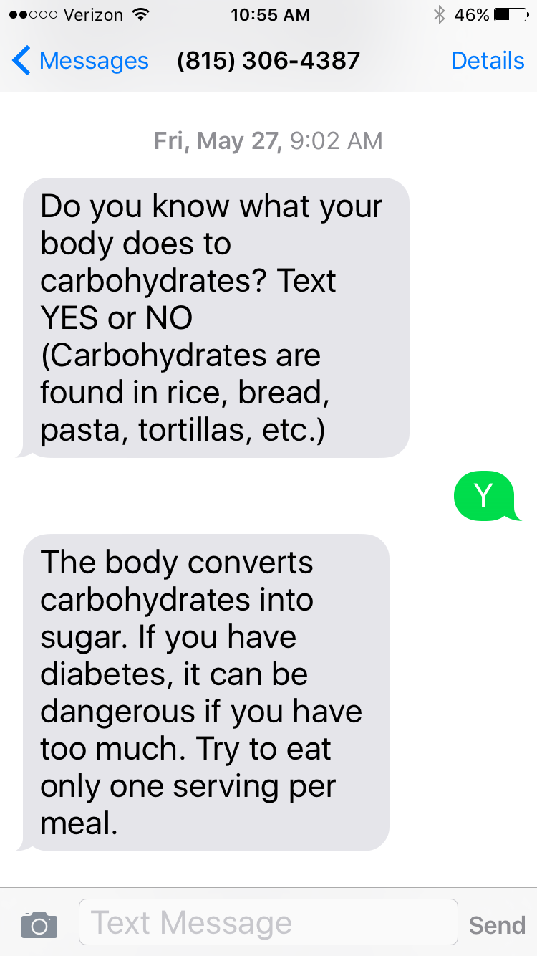
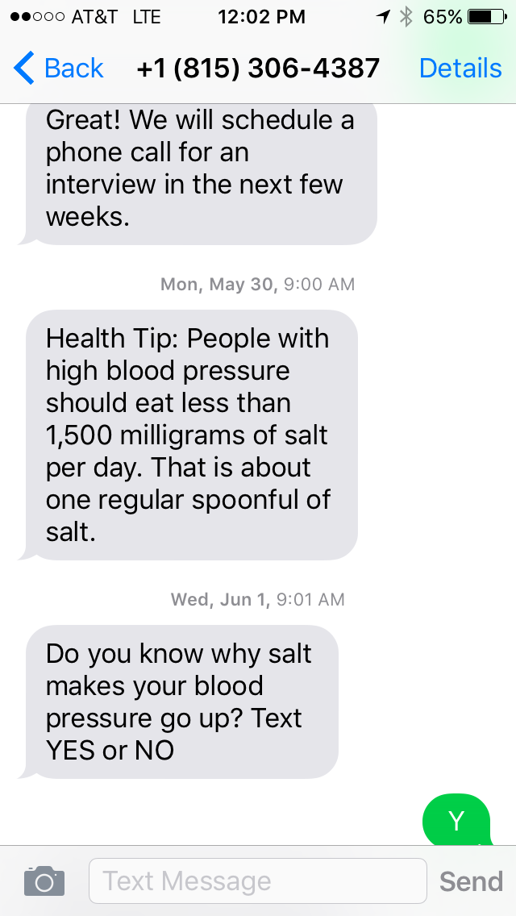
Notes:
Just to give you a visual, on the left is one of the diabetes texts we sent. On the right is one of the hypertension texts. Some messages were educational; others prompted patients to reflect on how they approach their disease and what they feel their challenges are. Great thing about CareMessage is the texts are geared toward limited health literacy patients. Delivered in small bits at a time

Slide 17
How did we do?
Measure | Pre- intervention | Post- intervention
A1C <8 | 35% | 44%
No-show rate | 10.3% | 7.8%
A1C group average | 8.83 | 8.71
Notes:
At FHPC, there were 3 groups of patients who went through the texting programs: 2 diabetic groups and one hypertension group. These results are only for the first diabetic group; still awaiting follow-up among the other groups. But across the board, the results are positive.

Slide 18
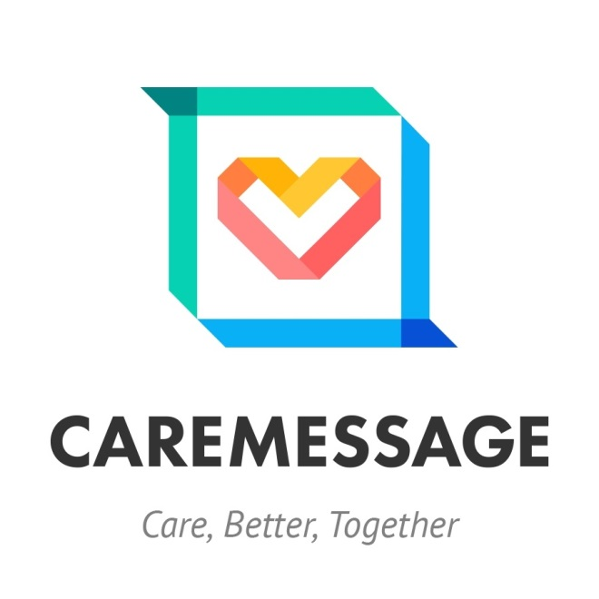
Notes:
A little more about CareMessage. one of a number of companies clinics might choose for a texting platform.
CareMessage is a San Francisco based non-profit that offers text-based health interventions and appointment reminders. While it also offers solutions to private sector health organizations, CareMessage’s primary focus has been bringing mobile health technology to underserved populations. Here is an example of what the healthcare provider sees on the CareMessage dashboard. This is for our first diabetic group. You can see the response rate of 45%. The retention rate of 100% (no one opted out; all completed the program)

Slide 19
In addition to diabetes and hypertension, CareMessage has texting programs available for Preventive Care Screenings, Women and Children’s Health, Chronic Disease, and Behavior Change.
Notes:
AmeriCares comments ….

Slide 20
For patients: Usually no cost, depending on cell phone plan For clinics: Generally low-cost; many companies trying to get their product in use; maybe free!
Notes:
For patients, the cost should be nothing. You have to be mindful of patients who do not have unlimited texting plans. Those are still out there. Our front office staff said they have not heard from patients that they are being charged for texts.
Costs for the clinic are pretty minimal too. The only in-house technical requirement is access to the Internet.
Subscription programs to texting platforms can be found for less than $1,000 per year. But, the market is really exploding right now. So companies may be willing to offer free trials because they need real patients to test drive their product; they would love to have data on real-world experiences with their platform.

Slide 21
Privacy and consent: HIPAA and TCPA
The Telephone Consumer Protection Act Text protects consumers by providing them with the ability to control who they receive auto-dialed and pre-recorded marketing calls from.
Exempted are health care messages relating to:
Appointments and exams
Confirmations and reminders
Wellness checkups
Hospital pre-registration instructions
Pre-operative instructions
Lab results
Post-discharge follow-up intended to prevent readmission
Prescription notifications
Home healthcare instructions
Must not include any accounting, billing, debt collection, and must comply with HIPAA privacy rules⁷
Notes:
And now for the fine print. We all know what HIPAA is; clinics who are going to text their patients also need to know something about the TCPA. The TCPA exempts health care messages from the more strict rules that apply to calls or texts for marketing purposes. So texting patients educational information or appointment reminders would be considered exempt, provided the messages follow the rules:

Slide 22
(TCPA continued)
For messages to be exempt, the following
requirements must be met:
The message must be free to end users
The message can only be sent to the cell number provided by the patient
The message must state the name and contact information of the health care provider
The message may not include any telemarketing, solicitation or advertising, or accounting, billing, debt collection or other financial content.
The text is limited to 160 characters
Only one message can be sent per day, and no more than three messages can be sent per week from a specific health care provider
The message must include a key press-activated opt-out mechanism
The health care provider must immediately honor any “opt-out” request.

Slide 23
Throwing tomatoes
Notes:
One more to go …

Slide 24
Privacy and consent
“Prior express consent”
What is considered PHI?
Security concerns – HIPAA’s Security Rule specifies security standards for disclosure and safeguarding of PHI.
Text messages create electronic records of the content of conversations while pages and phone calls do not.
Encryption and authentication are difficult if not impossible when using cellular networks.
Kings County, Washington public health department case study: “The biggest point of tension between text messaging and HIPAA is that personalization is considered one of the most effective ways to reach people with texting, but personalized texts are also the most likely to contain PHI.”⁸
Notes:
Picture that you have just been put in charge of setting up your clinic’s new texting program. Do you know how you will get consent to text your patients? If they provide you their cellphone number, is that considered consent? Or do you need separate written consent? Based on my research, if you are signing them up for an educational program like the diabetes and htn one we did, separate written consent is a good idea. These pts. Received 3 msgs a week for 12-16 weeks, so that’s like 40 messages. That level of contact is a lot different than receiving appointment reminders occasionally. TCPA says “prior express consent” is required but case law since then has found voluntarily providing a phone number alone gives consent.
But then there’s HIPAA ‘s Security Rule, which specifies security standards for disclosure and safeguarding of PHI.
What is considered PHI? Even demographic information can be considered PHI, so even if you are not sending lab results, the Security Rule applies. Some things to consider: 1, 2. The Kings County Washington public health department details its struggle with complying with these laws. They wanted to send a reminder to parents of children who had received an initial flu shot, but the text message contained the child’s name and indicated it was time for their second flu shot. Their issue was that even though they had consent to text this information, that the cellular networks cannot provide a secure closed connection and thus this PHI was not being sent in a secure way. Their solution was to eliminate the name and make the message more generic, which they argue is less effective.

Slide 25
Resources
AHRQ-funded Toolkit produced by Univ. of Colorado School of Medicine: http://www.ucdenver.edu/academics/colleges/medicalschool/programs/crisp/training/toolkits/textingtoolkit/Pages/default.aspx
HIMSS website http://www.himss.org/library/mhealthC
Center for Care Innovations Texting Toolkit http://www.careinnovations.org/knowledge-center/texting-for-better-care-toolkit
Privacyrights.org
Notes:
Some resources if your clinic is considering a texting program:

Slide 26
References
¹World Health Organization. (2011) mHealth: New Horizons for Health through Mobile Technologies: Based on the Findings of the Second Global Survey on eHealth (Global Observatory for eHealth Series, Volume 3). ISBN: 978-92-4-156425-0.
²Pew Research Center. (October 2015) by Monica Anderson. The Demographics of Device Ownership. Retrieved from http://www.pewinternet.org/2015/10/29/the-demographics-of-device-ownership/
³Slack, W. V. (1978). Patient counseling by computer. Proceedings of the Annual Symposium on Computer Application in Medical Care, , 222-226.
⁴ Sands, D. (2016) Proceedings of the Population Health Forum, HealthCare IT News. Retrieved from http://mobihealthnews.com/content/society-participatory-medicine-co-founder-health-happens-between-visits.
⁵Chow, C. K., Redfern, J., Hillis, G. S., Thakkar, J., Santo, K., Hackett, M. L.. . Thiagalingam, A. (2015). Effect of lifestyle-focused text messaging on risk factor modification in patients with coronary heart disease: A randomized clinical trial. JAMA, 314(12), 1255.

Slide 27
References
⁶Direct Marketing Association. Telephone Consumer Protection Act (TCPA), Robocalls and Text Messaging. Retrieved from https://thedma.org/resources/compliance-resources/tcpa/
⁷Jacobs, M.R. & Kane K.R. (September 2015) “FCC Clarifies TCPA Exemptions for Health Care Calls.” Michelman & Robinson LLP. Retrieved July 12, 2016 from http://www.mrllp.com/blog-fcc-clarifies-tcpa-exemptions-for-health-care-calls
⁸Comstock, J. (February 2013) “How HIPAA Hampers Text Messages for Health.” MobiHealth News. Retrieved from http://mobihealthnews.com/20440/how-hipaa-hampers-text-messages-for-health

Slide 28
Questions? Mike Romagnoli, Community Health Care Clinic mromagnoli@chcconline.org (309) 888-5531 www.chcchealth.org (Appointment reminder integration) Laurie Sabol, Family Health Partnership Clinic lsabol@hpclinic.org 779-220-9300 www.hpclinic.org (Chronic disease texting program) Starting your own program? We would be happy to talk further about our experience.

