Slide 1
Welcome to the 9th Annual IAFCC Conference Stronger Together

Slide 2
Welcome from Illinois Association of Free and Charitable Clinics
Suzann Hoban, IAFCC Chair, Executive Director - Family Health Partnership

Slide 3
IAFCC Board of Directors
Chairperson
Suzanne Hoban, MPH
Executive Director
Family Health Partnership Clinic
Vice Chair
Jeffrey Trask, PhD
Founder, Champaign County Christian Health Center
Treasurer
Jeffrey Trask, PhD
Founder, Champaign County Christian Health Center
Secretary
Luvia Quinones, MPP
Health Policy Director
Illinois Coalition for Immigrant & Refugee Rights

Slide 4
IAFCC Board of Directors cont.
Director
Julie Darnell, Ph.D. MHSA
Associate Professor of Public Health Sciences
Director, Bachelor of Science in Public Health Program
Parkinson School of Health Sciences and Public Health
Loyola University Chicago
Director
Christina Elizabeth Rodriguez-Estrada , MS
Social Media Specialist/ Digital Communications Strategist
Health Care Service Corporation
Director
Mike Romagnoli, MA
Executive Director
Community Health Care Clinic
Director
Shawn West-Marconi, MBA,SPHR
Executive Director
Will-Grundy Medical Clinic

Slide 5
IAFCC Board of Directors cont.
Director
David Wywialowski, MA, Mdiv
Director of Health Outreach & Health Ministry
The Night Ministry

Slide 6
Welcome from the IAFCC Conference Committee Chair
Julie Darnell, Ph.D. MHSA
Associate Professor of Public Health Sciences
Director, Bachelor of Science in Public Health Program
Parkinson School of Health Sciences and Public Health
Loyola University Chicago

Slide 7
IAFCC Conference Committee
Chair- Julie Darnell
Lyzeth Mondragon
Christina Rodgriguez
Jeffrey Trask
Mary Polwika
Pat Montemurro

Slide 8
Thank You Conference Supporters
Sponsors
Exhibitors

Slide 9
Thank you IAFCC Supporters
please put in logos
VNA
CNCS
Blowitz Ridgeway
Healthy Communities

Slide 10
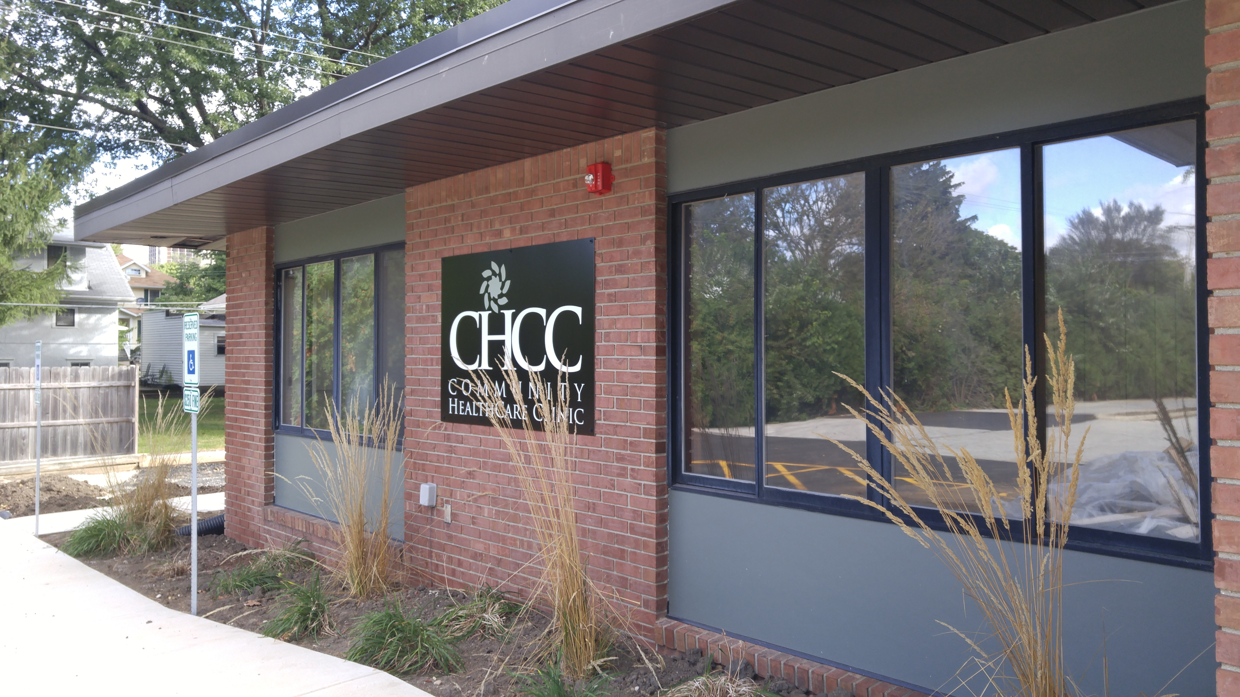
Innovation Award
Presented to : Community Health Care Clinic
CAATCH (Coordinating Appropriate Access to Comprehensive Care
Mike Romagnoli- Executive Director
In 2017, CHCC launched its hospital referral program CAATCH (Coordinating Appropriate Access to Comprehensive Healthcare) to help "catch" patients visiting local emergency departments and connect them with primary care providers in the community. Since then the program has saved participating hospitals millions of dollars in prevented hospital admissions, and established scores of patients at CHCC and other local providers.

Slide 11
IAFCC Committee Update
Governance Committee
Recruit and retain IAFCC Board Members and provide development opportunities for IAFCC Board of Directors.
Recruit
IAFCC Committees

Slide 12
Governance Committee
Committees
The Quality Improvement Committee initiates, collects and disseminates data to improve clinical care within the association.
The Advocacy and Policy Committee is responsible for guiding the Association in advocating for and developing policies that address the health care gaps of the uninsured and underinsured in Illinois. A priority of the committee will be to advocate for policies and resources that support Free and Charitable Clinics in Illinois as a valuable member of Illinois’ safety net.
The Conference Advisory Group is responsible for overseeing the IAFCC Annual Conference. Activities include guiding content as well as securing speakers, sponsors, exhibitors, and resources for the conference. The Committee also assists in planning the logistics for the conference. The committee provides leadership and support during the conference

Slide 13
Governance Committee
2019
1) Recruit members using Board Recruitment Diversity Matris
2) IAFCC Board Member Assessment
3) Board Retreat
Reviewed IAFCC Strategic Priorities for upcoming year
IAFCC Board Member Recruitment for 2020
Engage in IAFCC Committee
Application- Spring 2020-

Slide 14
IAFCC Committee Update
Advocacy and Policy Committee
Policy Priorities of the Illinois Association of Free and Charitable Clinics
-Increase the Awareness of the Sector
- Amend the Good Samaritan Act to include “charitable clinics” and to cover the
clinics as entities

Slide 15
Advocacy and Policy cont.
How we the committee accomplished this
Late Summer 2018- In person Training “ How to Tell Your Story to Legislators”
Fall 2018- In person Meeting at the IAFCC Annual Conference
Next Steps was to schedule a day in Springfield
March 2019- Free and Charitable Clinic Day in Springfield
May 2019- In person meeting to review day and plan next steps.
Schedule in person meetings with legislators
August 2019 Free and Charitable Clinics Month
Legislators were invited to visit clinics
Scheduled visits with state legislators
September - November 2019
Continue to meet with legislators

Slide 16
Advocacy and Policy Committee
Lessons Learned
Be prepared before the meeting
Know your elevator speech
Have an answer to the question - “What would you like”
Be flexible
Don’t have to answer all questions- however follow up right away
Use connections

Slide 17
Illinois Association of Free and Charitable Clinics
2019 Data Quality Improvement Committee Presentation

Slide 18
How Clinics Are Arranging Medication for Patients
Arrangement Method – Total Number of Clinics
Physician prescription - 12
Physician samples - 11
Drug company patient assistance program - 10
Drug company bulk donation/replacement - 9
Charitable distributor donation (i.e. Americares) - 9
Charitable fill pharmacy on-site - 8
Charitable fill pharmacy off-site - 7
340(b) drug program - 7
Stock bottles - 6
Pay outside pharmacy/pharmacy voucher - 5
Pay for specific (not stock or bulk) patient medications - 2
Generics through $4 Walmart plan - 2
Other (Education on Access and PBM/CVS Caremark - 2
Reflects data from 13 health clinics

Slide 19
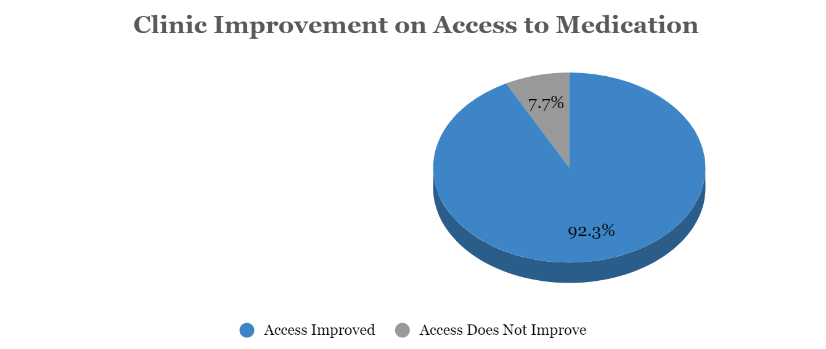
Access to Medication
Total number of filled/dispensed Rx prescriptions this quarter: 22,967
Reflects data from 13 health clinics

Slide 20
Clinic Improvements Caused by Grant Provision
A - Purchased Medication for Pharmacy/Dispensary
B - *Other
C - Expanded Pharmacy/Dispensary Hours
D - Provider Volunteers Increased
E - Expanded Clinic Hours
F - Paid Annual Fees for Free or Reduced Cost Medication
*Other: Purchase of a new pharmacy tracking program, individual patient medication purchases, hired a pharmacy tech, and strengthened strategies.
A *B C D E F
Reflects data from 13 health clinics

Slide 21
Total Spending Amount: $133,468.30
Reflects data from 13 health clinics

Slide 22
Data Quality Improvement Patient Outcomes: PATIENT OUTCOMES: Percentage of Patients with Glycemic Control- A1c<8

Slide 23
Data Quality Improvement Patient Outcomes: Percent of Patients with Blood Pressure <140/90

Slide 24
Where Would Patients Go if the Clinic Were Not Here?
Reflects data from 13 health clinics

Slide 25
Thank You From our Sector!!!

Slide 26
IAFCC Committee Update
Data Quality

Slide 27
State Wide Initiatives
VISTA- Access to Care

Slide 28
State Wide Initiatives
Access to Medication

Slide 29
IAFCC Update

Slide 30
Keynote Address
This slide is a place holder for the luncheon Key Note Address- Dr. Mason

Slide 31
Thank you

